Slide 1
Introduction to NVivo Part 3: Memos and Annotations
Alex Shermon | Research Computing Services

Slide 2

Welcome to Research Computing Services!

Slide 3
Digital Support Packs
During this time, we’ve moved our face to face training online.
Our trainings are now shorter, and are accompanied with an online learning lab.
This lab will help guide you through today’s training, and contains extra resources to help you learn NVivo!

Slide 4
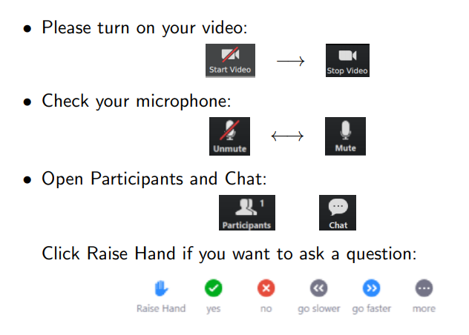
Zoom Etiquette

Slide 5
About Me
Masters of Global Media Communications Student
Omeka and NVivo Research Community Coordinator
Research Assistant on some neat archival projects
Playing SO MUCH Dungeons and Dragons right now

Slide 6
Today’s Learning Objectives
This workshop will teach you how to keep track of your project over time in NVivo
By the end of this workshop you will understand how to:
Create memos and annotations
The importance of file classifications
Create a Project Map

Slide 7
Memos and Annotations

Slide 8
The State of our Research Project
In Part 1, I imported interview transcripts and coded them
In Part 2, I created case classifications and cases to compare demographic attributes according to theme
Today, I want to take some time to critically reflect on my research question: what do these interviewees have to say about the water system in their local area and does this differ across demographic attributes? I will be:
Writing Memos and Annotations
Creating a Project Map
Assigning File Classifications

Slide 9
What are Memos?
Memos are a type of document designed to help you keep track of your research.
They are a way of keeping your data and your analysis separate but still contained within the same project file.

Slide 10
What are Annotations?
Annotations are like memos, but they are stored within and alongside the file themselves.
They are useful for tracking things like comments or observations about specific information within files or nodes.

Slide 11
For our Research Project
I’ve spent a few hours with my research, and it strikes me that I will one day need to begin writing up a paper about it.
There’s no better time than the present to begin writing, so I turn towards memos and annotations to help me with this process.
I’ll be using these to write down any ideas or insights that I have while I’m engaging with my research data.

Slide 12
Demo: Memos and Annotations
In this demo, I’ll show you how to create memos and annotations.

Slide 13
Challenge 1: Memos and Annotations
Create a Memo
Create an Annotation
Bonus Task: Link a memo to a file

Slide 14
2. File Classifications

Slide 15
What are File Classifications?
Remember Case Classifications? File Classifications are the same but for the files within your research project.
File classifications can help you provide metadata for your files.
Classification examples
Videos
Newspaper Articles
Books

Slide 16
For our Research Project
I’ve spent some time critically reflecting on my work, and I realise that my research project would benefit from incorporating some newspaper articles from the local area into my dataset for analysis.
I want my research to be as robust as possible, and because I’ve mastered case classifications, I feel comfortable with assigning file classifications.
This will help me down the line if I need to compare and contrast newspaper articles, looking at attributes like date, author, or publication!

Slide 17
Demo: Creating a File Classification
In this demo, I’ll show you how to create a file classification and to assign a file to that classification.

Slide 18
Challenge 2: Creating a File Classification
Create (or import) a File Classification
Assign a file to that classification
Assign values to the attributes in the classification

Slide 19
3. Project Maps

Slide 20
What are Project Maps?
Project Maps are a great way of starting to visualise how your research fits together.
They can show you links between your files, cases, and nodes!

Slide 21
For our Research Project
After a few glasses of wine, I’m still unable to properly conceptualise how my research project is looking. How does it all fit together?
Looking at all these different folders and tabs is a pain, so I want to create a visual representation of my research project.
So, I create either a Mind Map (Mac) or a Project Map (Windows) to start to see how my research project is looking!

Slide 22
Demo: Creating a Project Map
In this demo, I’ll show you how to create a Project Map.

Slide 23
Challenge 3: Creating a Project Map
Using the “Explore Tab”, create a Project Map
Drag and drop elements from your project into the Map to explore how it works

Slide 24
Wrapping up
This workshop has hopefully introduced you to ways to keep track of your research data in NVivo
In Module 4, we’ll be looking at other ways to visualise your research data in NVivo
You should know how to
Create memos and annotations
Create file classifications
Create a project map

Slide 25
Next Steps
In Module 4: We’ll look at ways of visualising your research data
As always, the GitBook contains extra videos and information to help you learn NVivo: http://go.unimelb.edu.au/2i3r (Module 5 on Lit Reviews is now up!)
Please fill in the feedback form:
Join the Facebook group if you have any questions: https://www.facebook.com/groups/unimelbnvivo
Get in touch with me at alex.shermon@unimelb.edu.au

Slide 26
Any Questions?

